Slide 1

Android Development
Part one

Slide 2
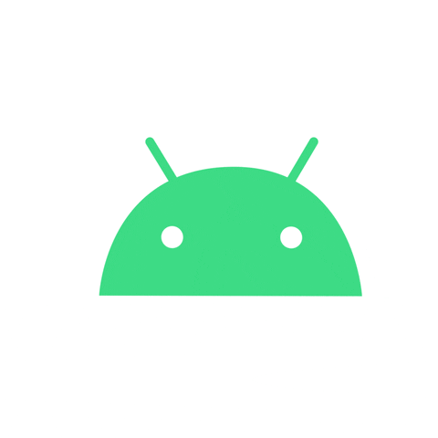
Intro to Android
A mobile operating system based on a modified version of the Linux kernel and other open source software.
Android is developed by a consortium of developers known as the Open Handset Alliance and commercially sponsored by Google.
First commercial Android device launched in September 2008.

Slide 3
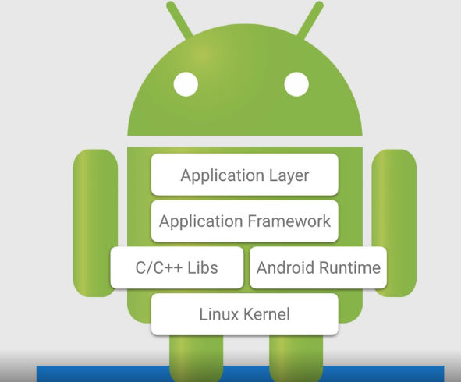
Android Software Stack
The Android software stack generally consists:
Linux kernel
A collection of C/C++ libraries that is exposed through an application framework that provides services, and management of the applications and run time.

Slide 4
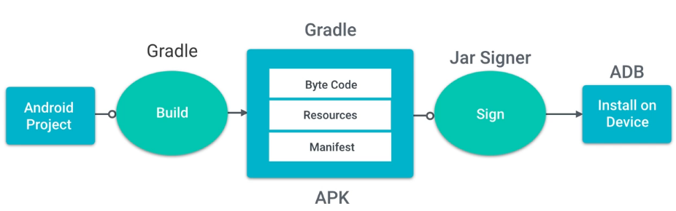
How Does it run?

Slide 5
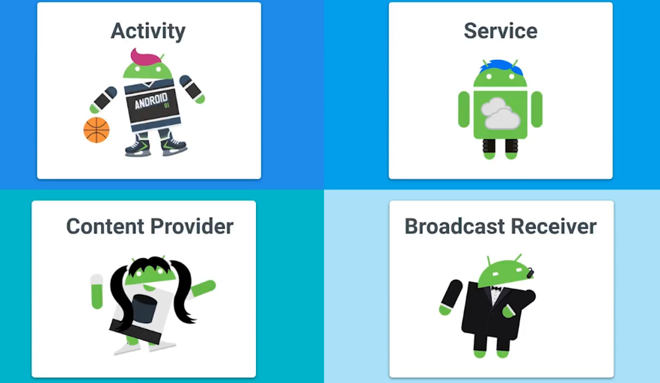
Android Application Components

Slide 6

What is Activity?
Single focused thing a user can do.
Responsible for creating the window that your application uses to draw and receive events from the system.
Activities are stacked to show various tasks on application.

