Slide 1

Android Development
Part Ten

Slide 2
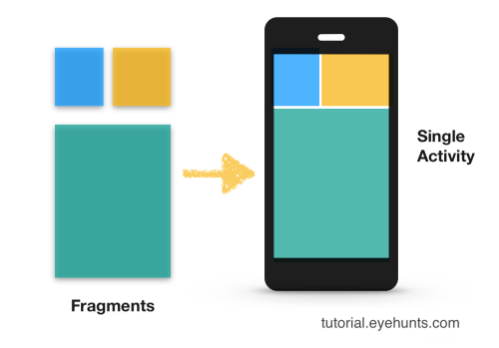
Fragments
Fragment is a class that represents a modular and reusable piece of an Activity.
A Fragment typically defines a part of a user interface. Fragments must be embedded in activities; they cannot run independently of activities.
For example: When you want to spilt the app into various parts so that it can be reusable for the desired view

Slide 3
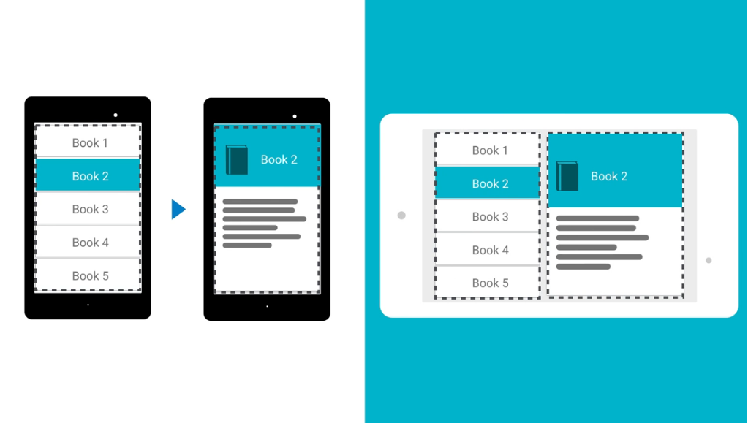
Splitting The UI Based on Phone/Tab

Slide 4
Preference Fragment
Android supports PreferenceActivity and PreferenceFragmentCompat to edit and store preferences.
It is easy to create a hierarchy of preferences (that can be shown on multiple screens) via XML.
When the user interacts with the fragment there is no code needed to create dialogs or new screens to handle input from the user or storage. This is a simple and powerful way to handle system preferences.
PreferenceFragmentCompat contains a hierarchy of preference objects as lists. These preferences will automatically save to SharedPreferences as the user interacts with them.

Slide 5
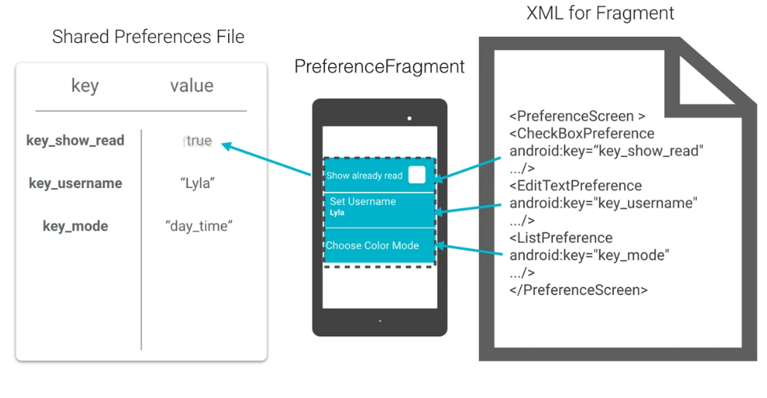
How Does it work?

