Slide 1

Android Development
Part Eleven

Slide 2


SQLite Database
SQL is a standard language for storing, manipulating and retrieving data in databases.
SQLite is a opensource SQL database that stores data to a text file on a device. Android comes in with built in SQLite database implementation.
SQLite supports all the relational database features. In order to access this database, you don't need to establish any kind of connections for it like JDBC,ODBC etc.

Slide 3
Database Schema and Contract
One of the main principles of SQL databases is the schema: a formal declaration of how the database is organized. The schema is reflected in the SQL statements that you use to create your database.
It is helpful to create a companion class, known as a contract class, which explicitly specifies the layout of your schema in a systematic and self-documenting way.
It is a container for constants that define names for URIs, tables, and columns. It allows you to use the same constants across all the other classes in the same package. This lets you change a column name in one place and have it propagate throughout your code.
A good way to organize a contract class is to put definitions that are global to your whole database in the root level of the class. Then create an inner class for each table. Each inner class enumerates the corresponding table's columns.
Doc: https://developer.android.com/training/data-storage/sqlite

Slide 4
Example of Our Party Invite
ID | Guest Name | Party Size | Timestamp

Slide 5
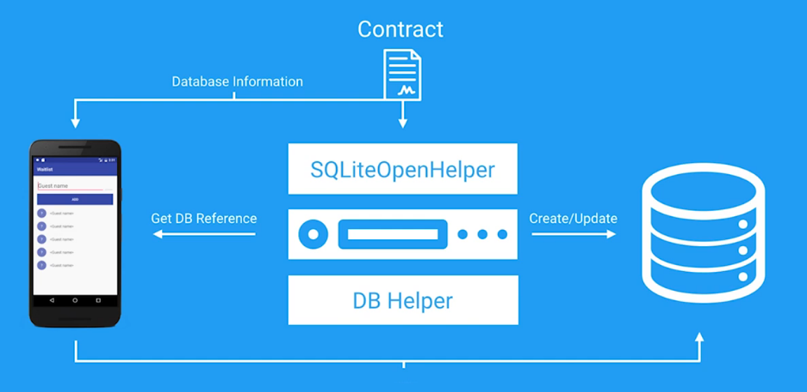

Slide 6
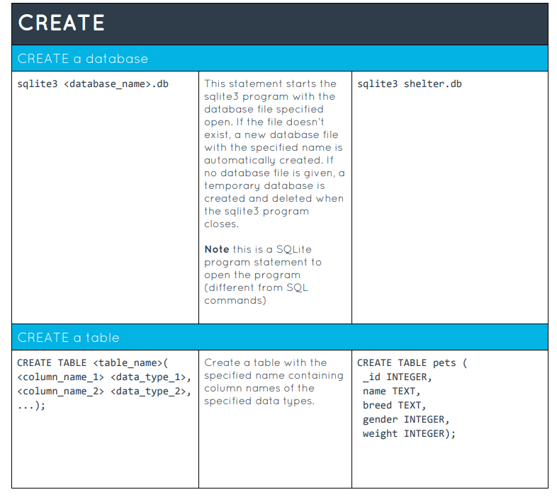
Database Create

Slide 7
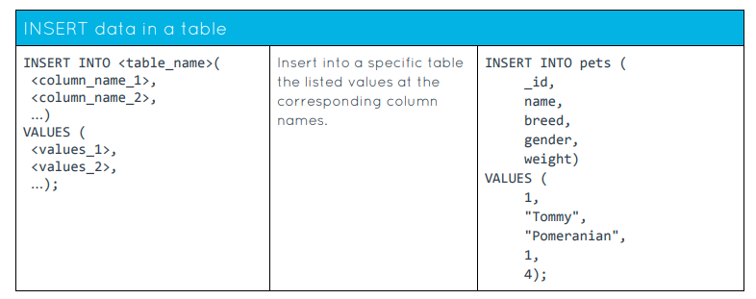
Database insert

Slide 8
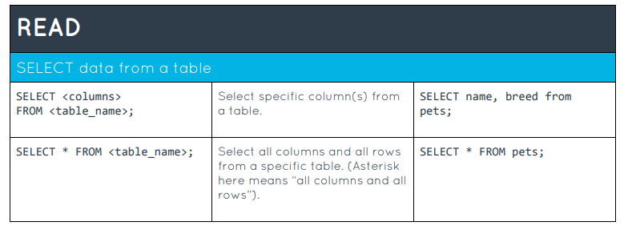
Database read

Slide 9
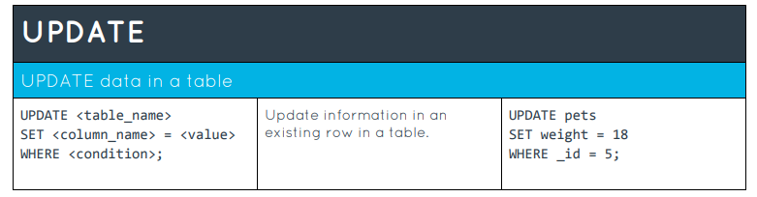
Database Update

Slide 10
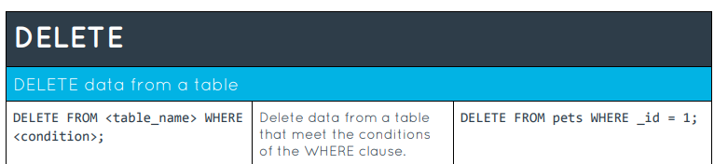
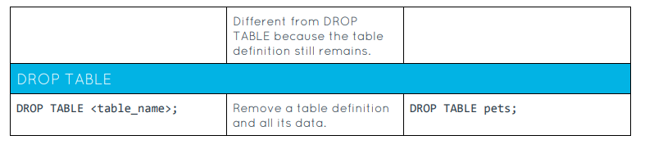
Database Delete

Slide 11
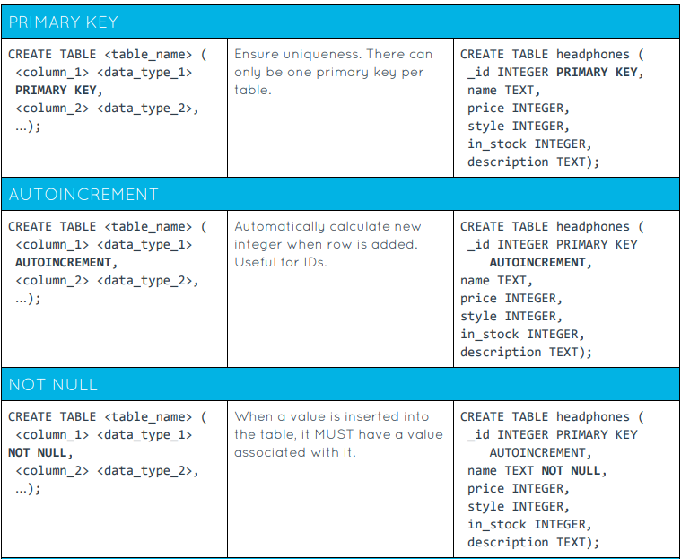
SQLite keywords

Slide 12
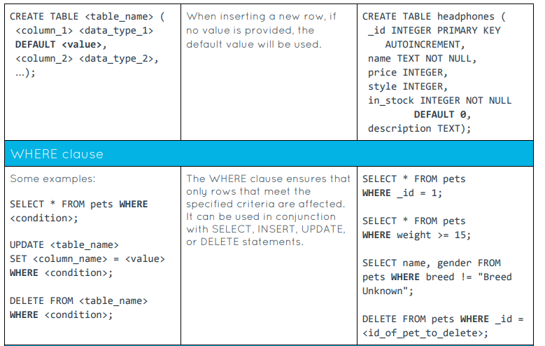
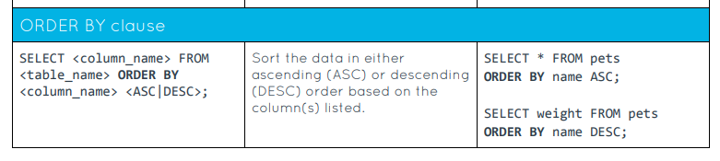
SQLITE KEYWORDS

