Slide 1

Android Development
Part Tweleve

Slide 2
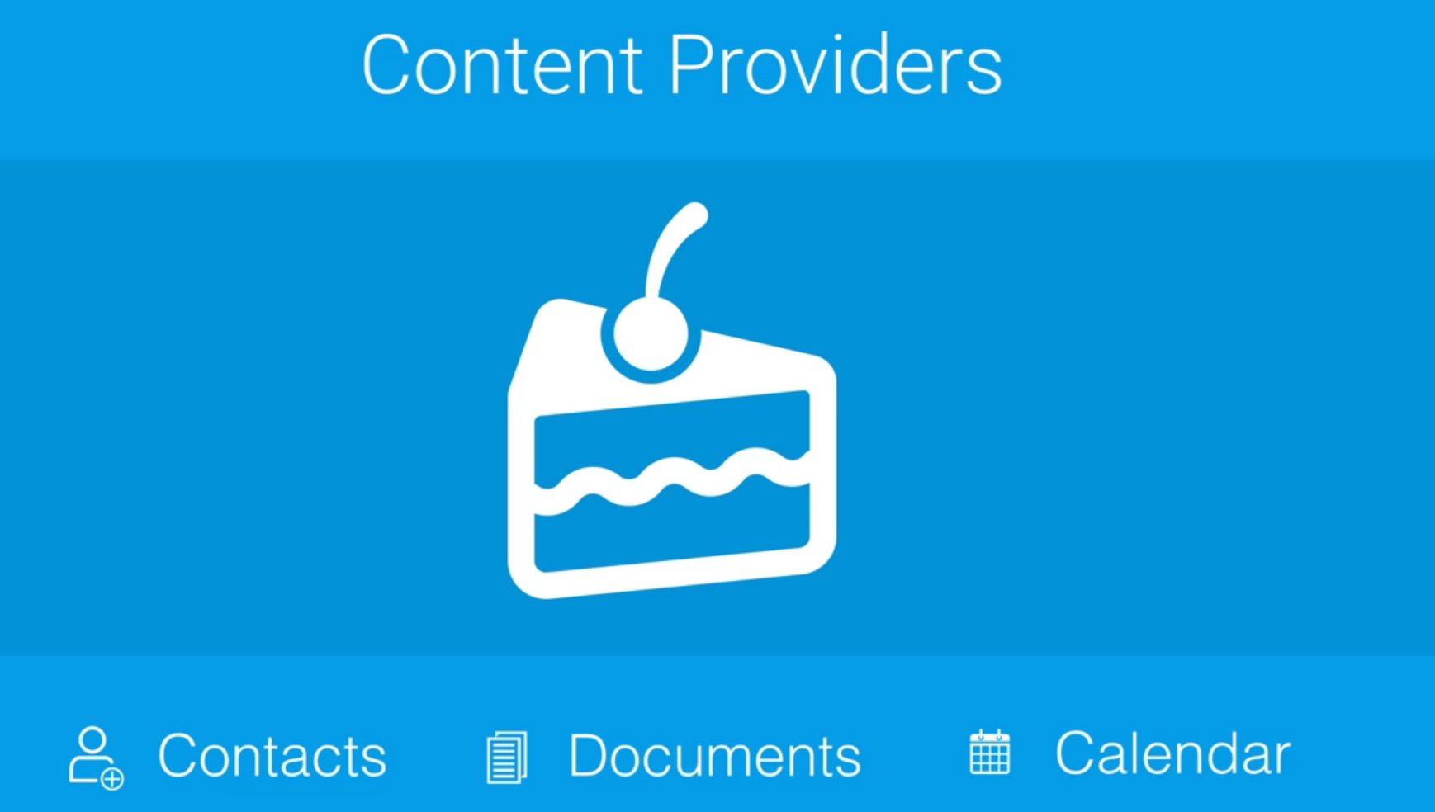
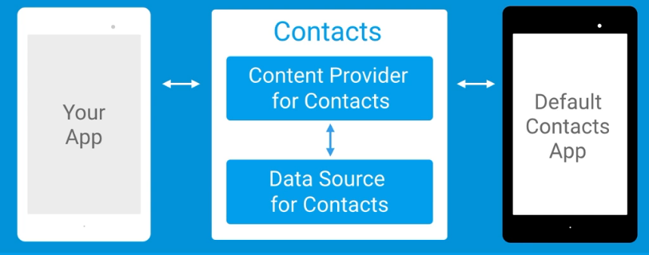
Content Providers
A content provider component supplies data from one application to others on request.
Such requests are handled by the methods of the ContentResolver class.
A content provider can use different ways to store its data and the data can be stored in a database, in files, or even over a network.
Content providers let you centralize content in one place and have many different applications access it as needed.

Slide 3
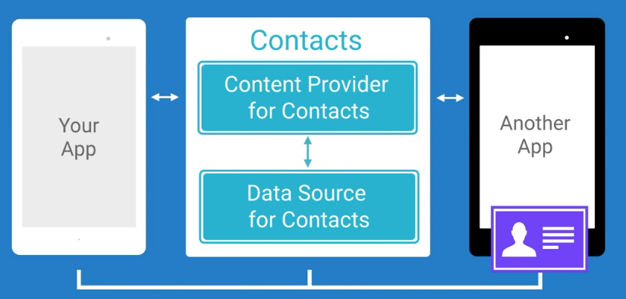
Reasons to use
Content Provider
Easily change underlying data source.
Leverage functionality of Android Classes. Ex: Loaders
Allow many apps to access, use and modify a single data source securely.

Slide 4
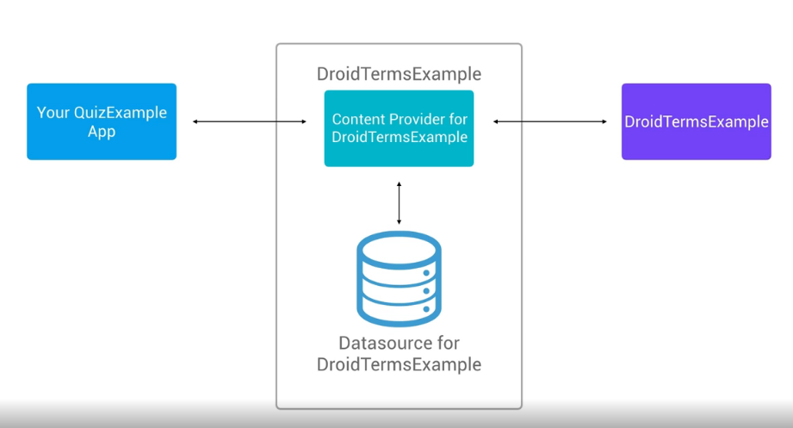
DroidTerms
Example

Slide 5
