Slide 1

Android Development
Part Fourteen

Slide 2
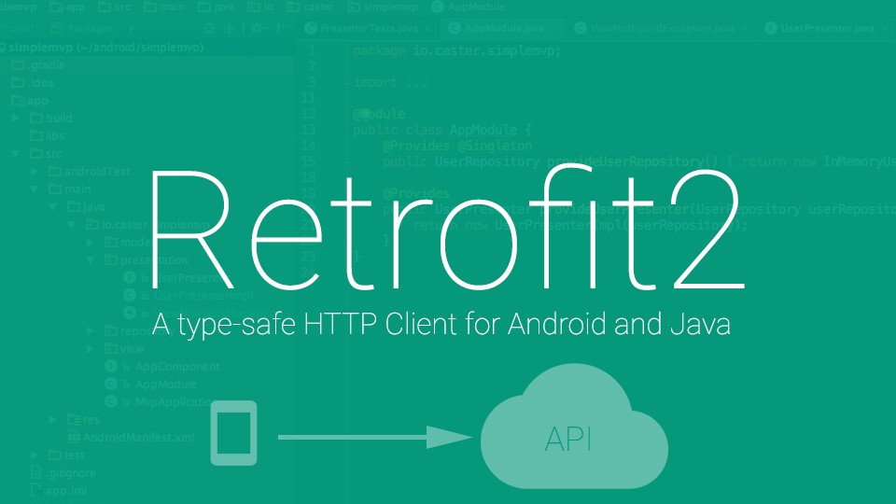
Retrofit
Retrofit is type-safe REST client for Android and Java which aims to make it easier to consume RESTful web services.
Retrofit 2 by default leverages OkHttp as the networking layer and is built on top of it.
Retrofit automatically serializes the JSON response using a POJO(Plain Old Java Object) which must be defined in advanced for the JSON Structure. To serialize JSON we need a converter to convert it into Gson first.

Slide 3
Convertors for Retrofit
By default, Retrofit can only deserialize HTTP bodies into OkHttp's ResponseBody type and it can only accept its RequestBody type for @Body.
Converters can be added to support other types. Six sibling modules adapt popular serialization libraries for your convenience.
  Gson: com.squareup.retrofit2:converter-gson
  Jackson: com.squareup.retrofit2:converter-jackson
  Moshi: com.squareup.retrofit2:converter-moshi
  Protobuf: com.squareup.retrofit2:converter-protobuf
  Wire: com.squareup.retrofit2:converter-wire
  Simple XML: com.squareup.retrofit2:converter-simplexml
  JAXB: com.squareup.retrofit2:converter-jaxb
  Scalars (primitives, boxed, and String): com.squareup.retrofit2:converter-scalars

Slide 4
Here's an example of using the GsonConverterFactory class to generate an implementation of the GitHubService interface which uses Gson for its deserialization.
Retrofit retrofit = new Retrofit.Builder() .baseUrl("https://api.github.com/") .addConverterFactory(GsonConverterFactory.create()) .build();
GitHubService service = retrofit.create(GitHubService.class);

Slide 5
API (Interface)
Calling
interface APIInterface {
@GET("/api/unknown")
Call<MultipleResource> doGetListResources();
@POST("/api/users")
Call<User> createUser(@Body User user);
@GET("/api/users?")
Call<UserList> doGetUserList(@Query("page") String page);
@POST("/api/users?")
Call<UserList> doCreateUserWithField(@Field("name") String name, @Field("job") String job);
}
String username = “manish";
Call<User> call = apiService.getUser(username);
call.enqueue(new Callback<User>() {
@Override
public void onResponse(Call<User> call, Response<User> response) {
int statusCode = response.code();
User user = response.body();
}
@Override
public void onFailure(Call<User> call, Throwable t) {
// Log error here since request failed
}
});
POJO
public class User {
@SerializedName("id")
public Integer id;
@SerializedName("name")
public String name;
@SerializedName("year")
public Integer year;
@SerializedName("pantone_value")
public String pantoneValue;
}

