Slide 1

Android Development
Part fifteen

Slide 2
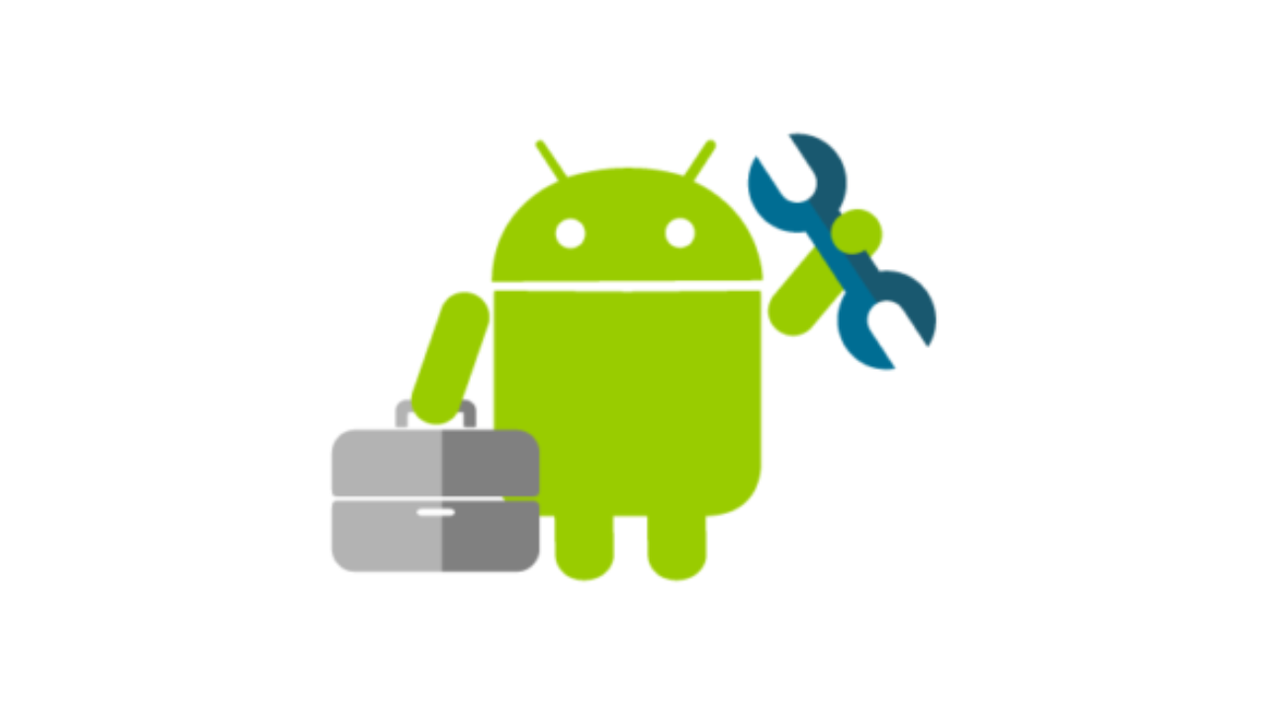
Services
A Service is an application component that can perform long-running operations in the background.
It does not provide a user interface.
Once started, a service might continue running for some time, even after the user switches to another application.
Additionally, a component can bind to a service to interact with it and even perform interprocess communication (IPC). For example, a service can handle network transactions, play music, perform file I/O, or interact with a content provider, all from the background.

Slide 3
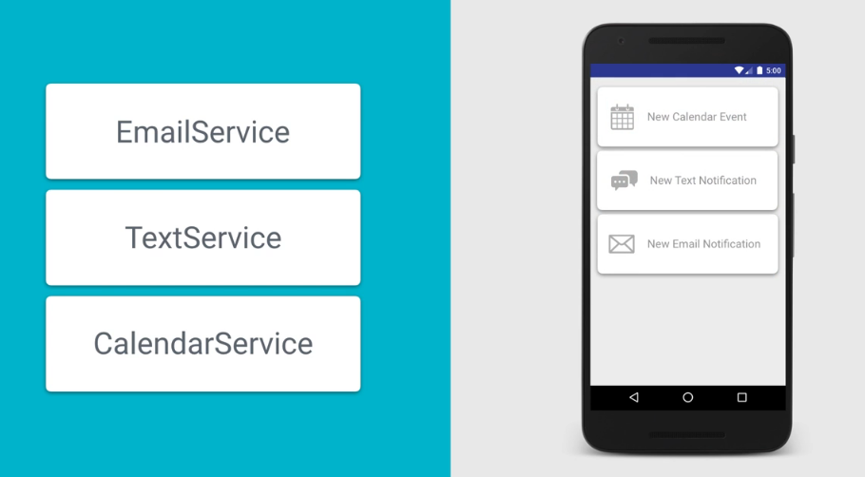
Use case For Services
Services are Android Framework Components meant for running long background tasks that don’t need a visual component.
Does not have an UI and it still runs even though activities are closed.

Slide 4
Services vs Loader
Loader
Tied to the activity lifecycle.
Easy to make user interface changes and communicate with Activity
Ex: Process or load data into UI
Service
Decoupled from the user interface.
Exists even when there is no user interface.
Ex: Process, upload or download that wont affect the UI. (Database Caching)

Slide 5
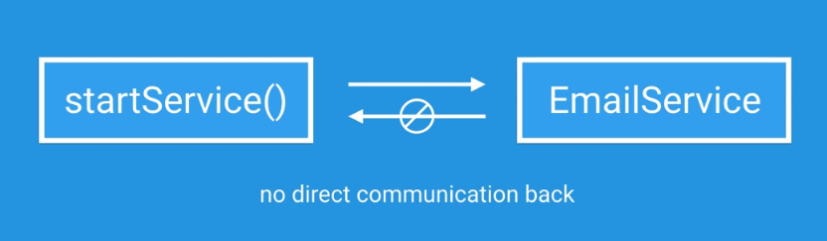
Ways to start a service
1. Start or Background Service

Slide 6
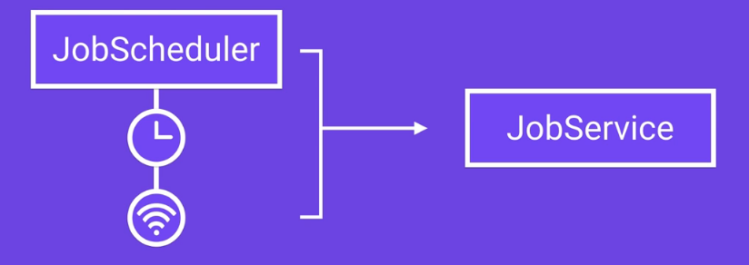
Ways to start a service
2. Schedule Service
A schedule service performs an operation that may need to run after certain cycles. It uses scheduler. For example, if an app has WIFI run a service then do certain action.

Slide 7
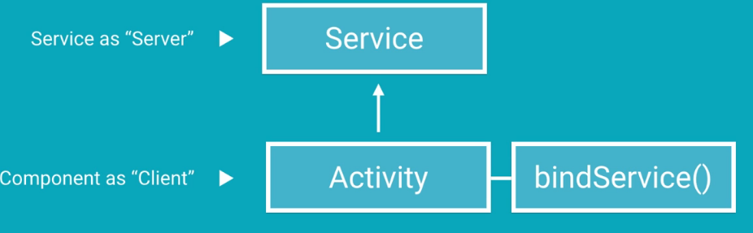
Ways to start a service
3. Bind Service
A service is bound when an application component binds to it by calling bindService(). A bound service runs only as long as another application component is bound to it. Communicates back and forth between. For ex: Media Application where you have to play music in background and activity that controls the UI.

Slide 8
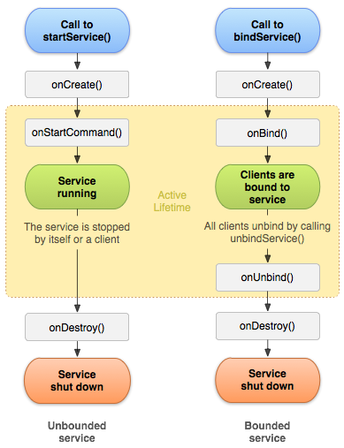
Lifecycle of services

