Slide 1

Android Development
Part Two

Slide 2

Threads In Android
When an application is launched in Android, it creates the first thread of execution, known as the “main” thread.
The main thread is responsible for dispatching events to the appropriate user interface widgets as well as communicating with components from the Android UI toolkit.
To keep your application responsive, it is essential to avoid using the main thread to perform any operation that may end up keeping it blocked.

Slide 3
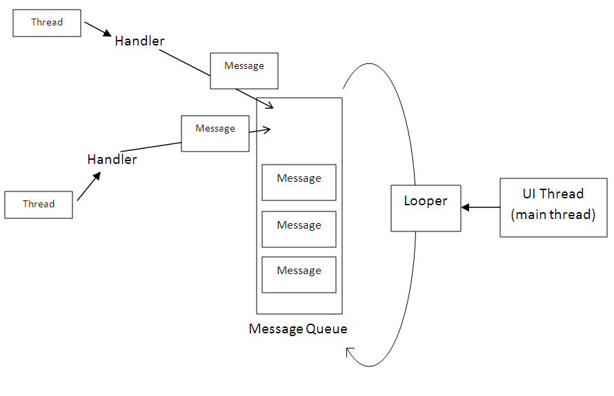
UI Thread

Slide 4

Why AsyncTask?
Network operations and database calls, as well as loading of certain components, are common examples of operations that one should avoid in the main thread.
When they are called in the main thread, they are called synchronously, which means that the UI will remain completely unresponsive until the operation completes.
For this reason, they are usually performed in separate threads, which thereby avoids blocking the UI while they are being performed (i.e., they are performed asynchronously from the UI).

Slide 5
Generic Types in Async Task
TypeOfVarArgParams − It contains information about what type of params used for execution.
ProgressValue − It contains information about progress units. While doing background operation we can update information on ui using onProgressUpdate().
ResultValue −It contains information about result type.

Slide 6
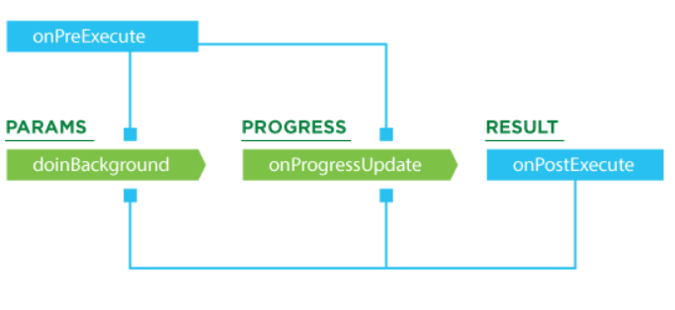
Methods Of AsyncTask
onPreExecute() − Before doing background operation we should show something on screen like ProgressBar or any animation.
doInBackground(Params) − We do background operation on background thread. Operations in this method should not touch on any main thread activities or fragments.
onProgressUpdate(Progress…) − While doing background operation, if you want to update some information on UI, we can use this method.
onPostExecute(Result) − In this method we can update ui of background operation result.

Slide 7
