Slide 1

Android Development
Part Four

Slide 2
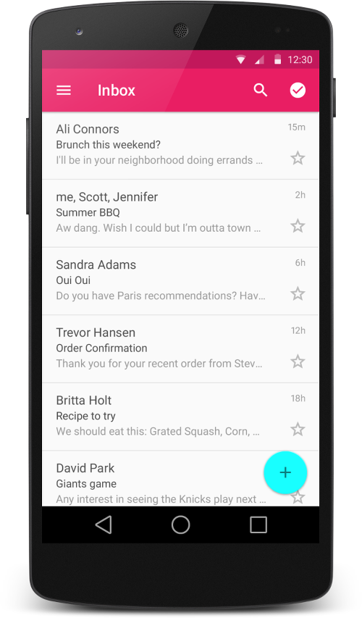
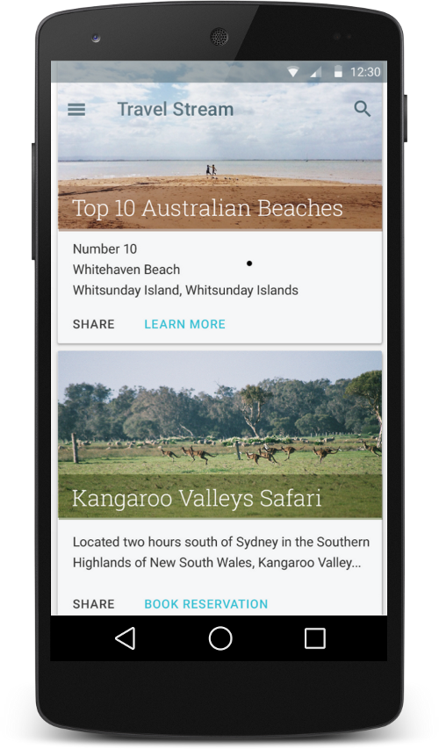
RecyclerView
The RecyclerView is a ViewGroup that renders any adapter-based view in a similar way.
It is supposed to be the successor of ListView and GridView.
When you have data collections whose elements change at runtime based on user action or network events.

Slide 3
Why RecyclerView?
Helps to create formats that we want as multiple or different views.
Helps to create layout and populate each views accordingly.
Manages loading into memory and also interaction with each view.

Slide 4
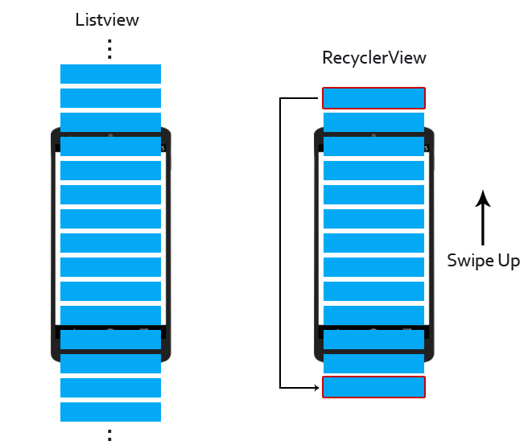
How RecyclerView Works?
It manages view according to user visible screen.
It keeps items in Recycle Bin or Queue to bind items if there are visible so that new content can be scrolled.
It does so by recycling old view back for new ones.

Slide 5
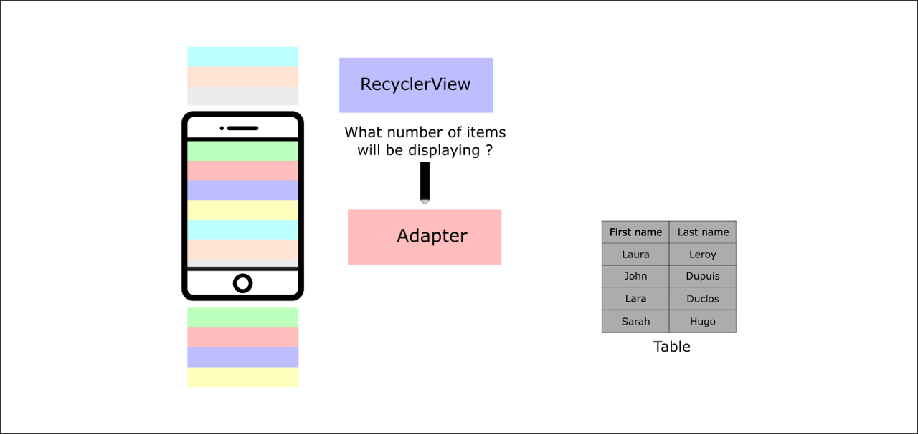
Part One: How It Works?
1. When the RecyclerView is being laid out and drawn → it will ask the Adapter for the numbers of items that will be displayed.

Slide 6
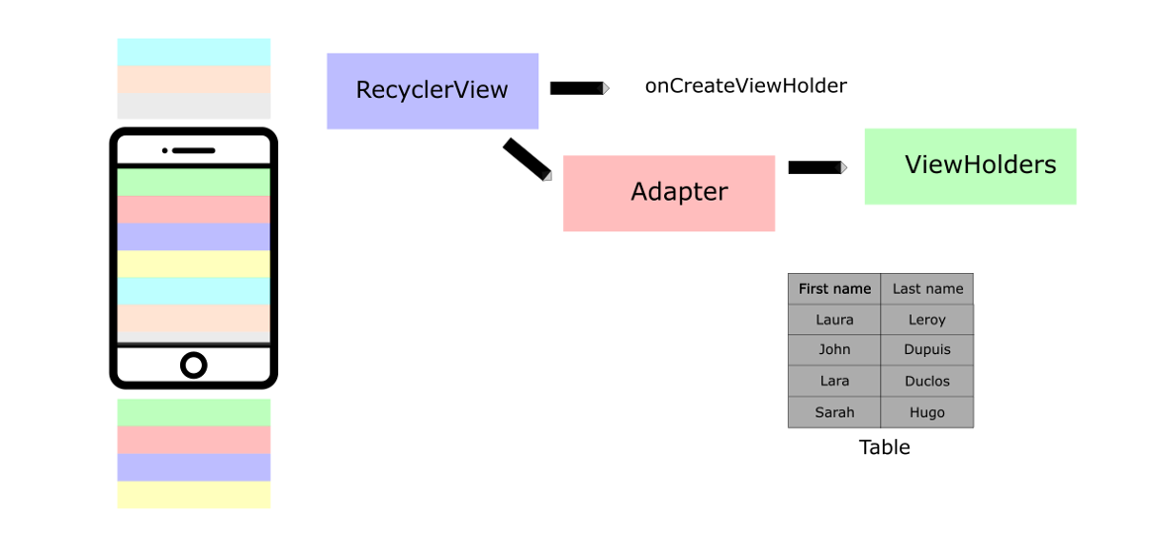
Part Two: How It Works?
2. Then, the RecyclerView will ask the Adapter to create ViewHolder objects. And the process, inflate individually item views from their corresponding XML by calling onCreateViewHolder.

Slide 7
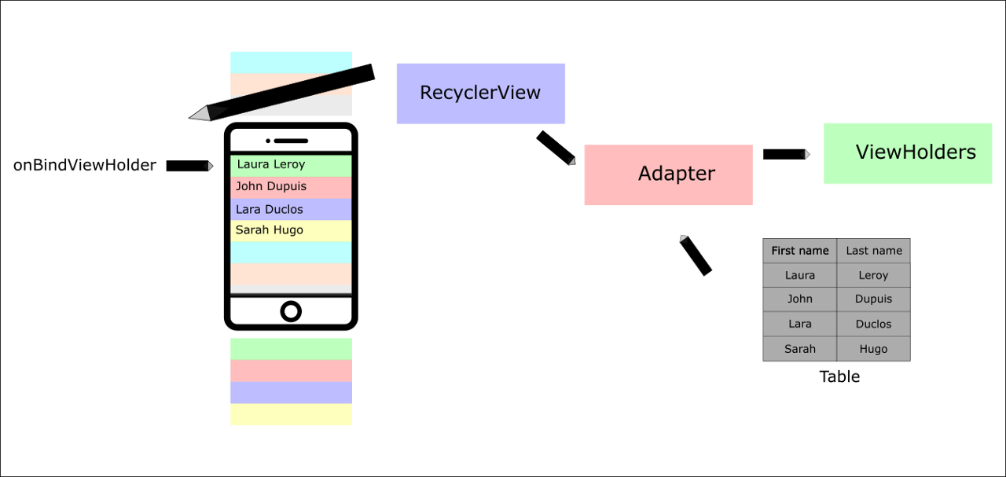
Part Three: How It Works?
3. After each ViewHolder is created, the RecyclerView will call onBindViewHolder to populate each item with data.
4. Then, when you scroll the RecyclerView will reuse those ViewHolders asking the Adapter to bind new data to them.

