Slide 1

Android Development
Part Five

Slide 2
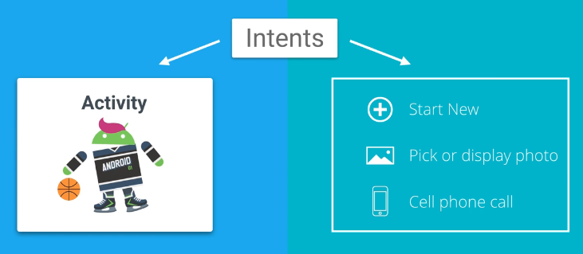
Intents
Android Intent is the message that is passed between components such as activities, content providers, broadcast receivers, services etc.
It is generally used with startActivity() method to invoke activity, broadcast receivers etc.
Android intents are mainly used to:
  Start the service
  Launch an activity
  Display a web page
  Display a list of contacts
  Broadcast a message
  Dial a phone call etc.

Slide 3
Types Of Intents
Implicit Intent
Implicit Intent doesn't specify the component. In such case, intent provides information of available components provided by the system that is to be invoked.
For example, you may write the following code to view the webpage.
Explicit Intent
Explicit Intent specifies the component. In such case, intent provides the external class to be invoked.
Intent intent=new Intent(Intent.ACTION_VIEW);
intent.setData(Uri.parse("http://www.javatpoint.com"));
startActivity(intent);
Intent i = new Intent(getApplicationContext(), ActivityTwo.class);
startActivity(i);

