Slide 1

Android Development
Part Eight

Slide 2
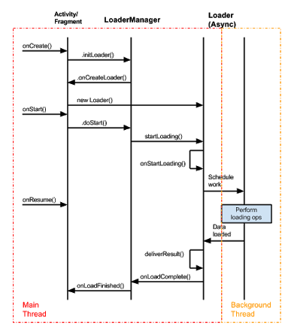
Loaders
Loaders make it easy to asynchronously load data in an activity or fragment. Loaders have these characteristics:
They are available to every Activity and Fragment.
They provide asynchronous loading of data.
They monitor the source of their data and deliver new results when the content changes.
They automatically reconnect to the last loader's cursor when being recreated after a configuration change. Thus, they don't need to re-query their data.

Slide 3
Starting a Loader
The LoaderManager manages one or more Loader instances within an Activity or Fragment. There is only one LoaderManager per activity or fragment.
You typically initialize a Loader within the activity's onCreate() method, or within the fragment's onActivityCreated() method.
A unique ID that identifies the loader. In this example, the ID is 0.
Optional arguments to supply to the loader at construction (null in this example).
A LoaderManager.LoaderCallbacks implementation, which the LoaderManager calls to report loader events. In this example, the local class implements the LoaderManager.LoaderCallbacks interface, so it passes a reference to itself, this.
// Prepare the loader. Either re-connect with an existing one,
// or start a new one.
getLoaderManager().initLoader(0, null, this);

Slide 4
Callbacks
Loader Manager
Loader
onCreateLoader(): Instantiate and return a new Loader for the given ID.
onLoadFinished(): Called when a previously created loader has finished its load.
onLoaderReset(): Called when a previously created loader is being reset, thus making its data unavailable.
forceLoad(): Force an asynchronous load. Unlike startLoading() this will ignore a previously loaded data set and load a new one.
deliverResult(): Sends the result of the load to the registered listener.

