Slide 1

Android Development
Part NINE

Slide 2

Data Persistence
Data Persistence is the act of saving some data to the phone.
There are five ways you can save the data:
Using SaveInstanceState
Using File System
  SharedPreferences
  SQLite Database
  Internal/External Storage
  Server (Ex: Firebase)

Slide 3
Saved
Instance State
Here the values are saved using key/value pairs i.e. bundle and help during configuration changes like app rotation.
It is temporary way to store that if the user is using the app.
If the user quits or restarts the data is lost.

Slide 4
Shared Preferences
Saves simple key/value to the android file system.
The keys are always String whereas the values are primitive data type like float, int, double, String.
Works until the app is not uninstalled
Ex: Used it to stored simple data of users/games.

Slide 5
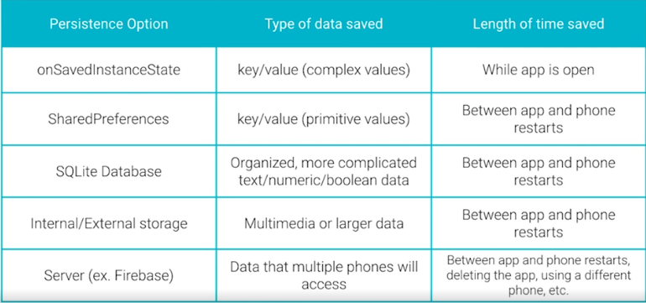
Different ways of Data Persistence

