Slide 1

Flutter Development
Part one

Slide 2

Tell me About you?
Your Name?
What do you want to create?

Slide 3
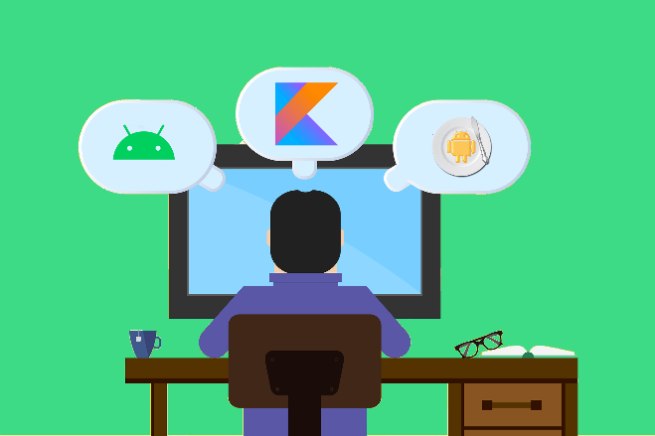
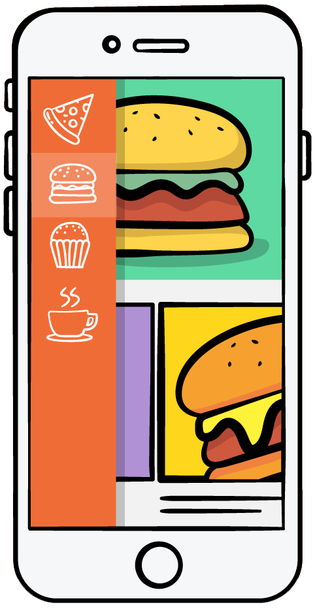
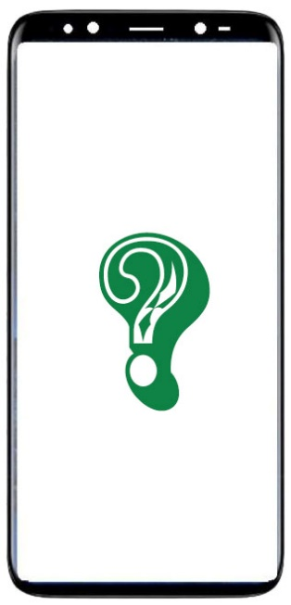
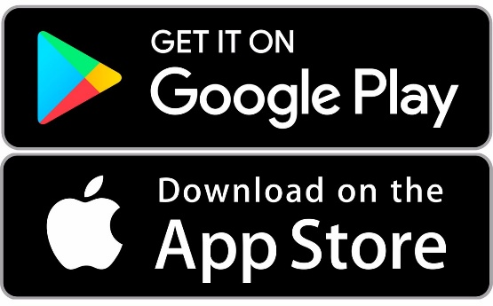

Overview
Android Development
Match Food App
When will it come to Android?
Bob
(iOS Developer)

Slide 4
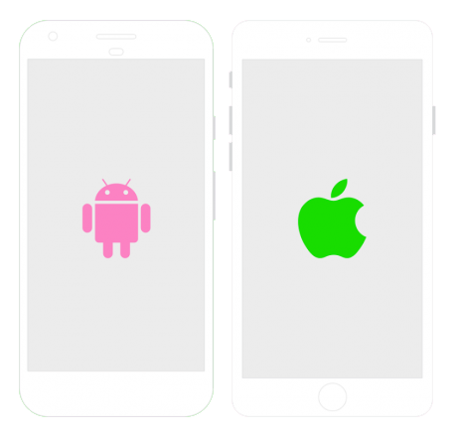
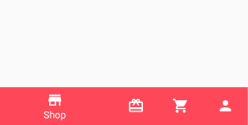
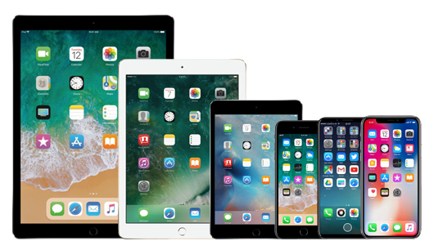
Problems
Weird Layouts
Manage 2 code bases
Multiple Screen Sizes

Slide 5
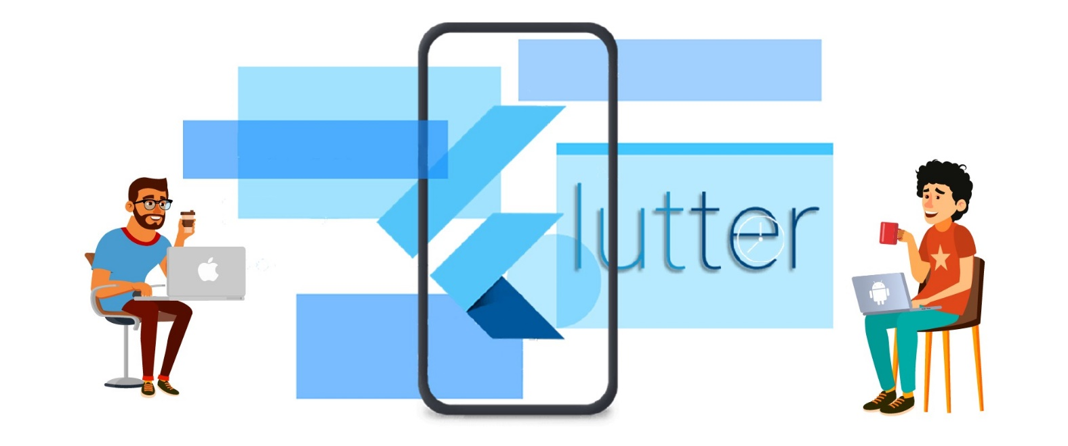
Solution
Flutter is a UI-Toolkit that makes developers to design applications for all screen sizes and devices.

Slide 6
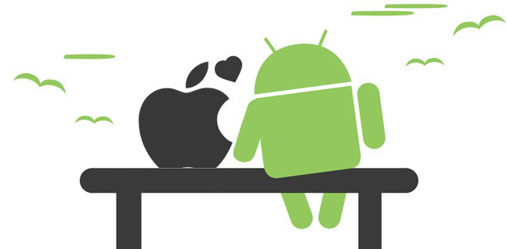
Introduction
Flutter is an application development framework from Google.
It’s a UI toolkit for building beautiful natively compiled applications (both for iOS and Android) as well as for web and desktop all from a single code base.
It aims to make the development as easy, quick, and productive as possible.
Flutter is loved because of its wide widget catalog, amazing performance and a well-organized community to contribute to meeting the goal. Hence flutter is blooming and is a pretty good framework.

Slide 7
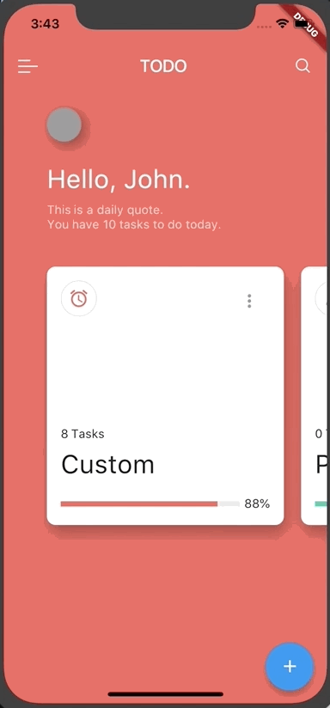
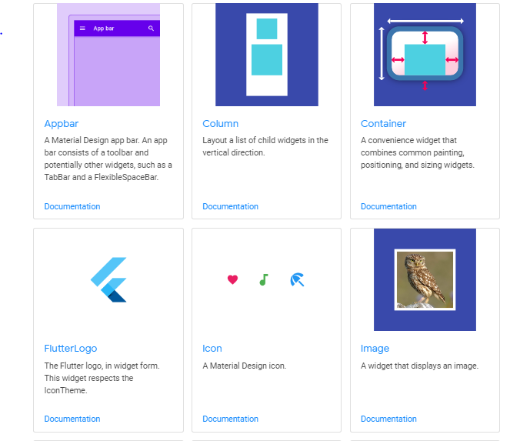
How Does Flutter Does it?
Flutter has whole bunch of prebuilt widgets that helps to layout your app.
It borrows some concepts from web design like centering, padding.
It does all by drawing the blank canvas by with flutter widgets.
Expressive, beautiful UIs and Animations

Slide 8
Fast and Productive
Brings the power of game engine.
60 fps, GPU accelerated
Compiled to native code.
Hot Reload in seconds.
More time to experiment and test

Slide 9
Deploy It Everywhere

