Slide 1

Flutter Development
Part Eleven

Slide 2
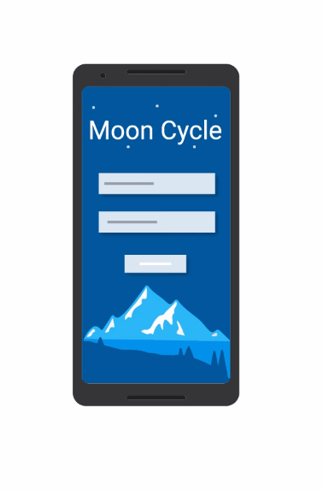
Animations In flutter
Flutter has a whole bunch of pre-build widgets to carry out animations smoothly in 60 FPS rendering.
Offical Docs: https://flutter.dev/docs/development/ui/animations/tutorial

Slide 3
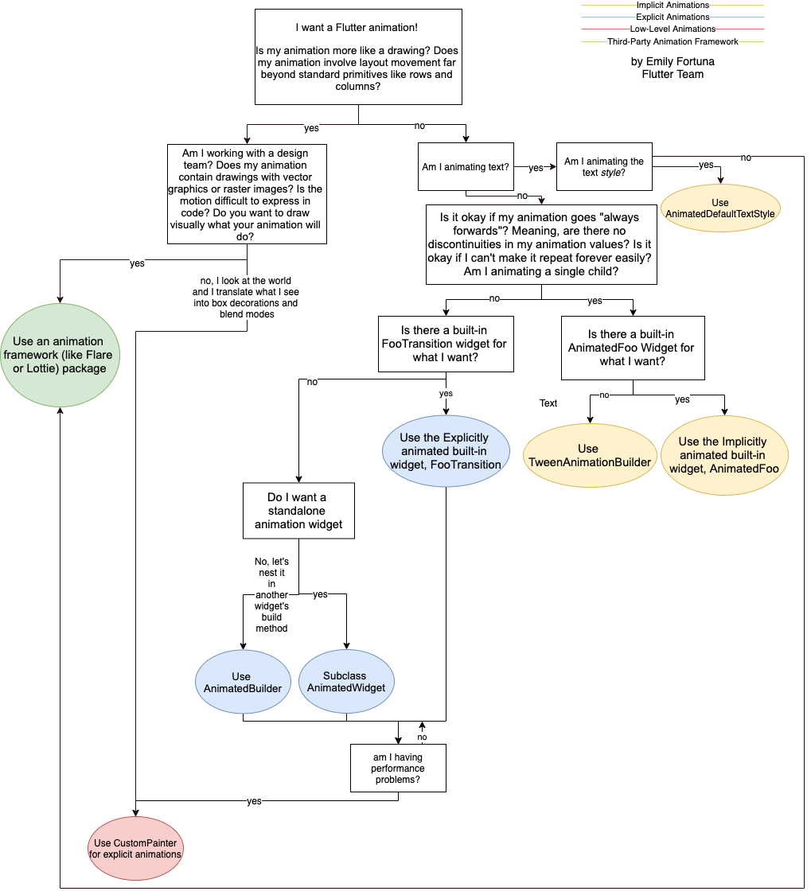

Slide 4
How Does Animations Work?
AnimationController: This manages the "Animation". It produces a new value for every frame that is rendered, keeps track of the animation state and exposes functionality to play (forward), reverse or stop an animation.
Animation / Tween: This defines the begin and end values along with how to how move from the beginning to end through a curve. This object will notify the controller through the ValueListenable protocol whenever the value it holds has changed.
Ticker: A ticker is a class that listens to frameCallback and calls a tick function that passes the elapsed duration between the current frame and the last frame to the ticker listener. In our case the controller.

Slide 5
Animated builder
AnimatedBuilder is useful for more complex widgets that wish to include an animation as part of a larger build function. To use AnimatedBuilder, simply construct the widget and pass it a builder function
If your builder function contains a subtree that does not depend on the animation, it's more efficient to build that subtree once instead of rebuilding it on every animation tick.
If you pass the pre-built subtree as the child parameter, the AnimatedBuilder will pass it back to your builder function so that you can incorporate it into your build.
Using this pre-built child is entirely optional, but can improve performance significantly in some cases and is therefore a good practice.

