Slide 1

Flutter Development
Part Two

Slide 2

Why Flutter?
One Code Base To Rule Them All.
One Place to Update.
One Place to Debug.
Huge advantage than learning different language for Android’s Java, iOS’s Swift and Web’s JavaScript.
Only need to get good a one thing.

Slide 3

Dart
The programming language flutter uses.
It’s like most of the modern object-oriented programming language.
Its used to build powerful tools such as Google AdWords and Fiber.
“One Codebase To Rule Them All”

Slide 4
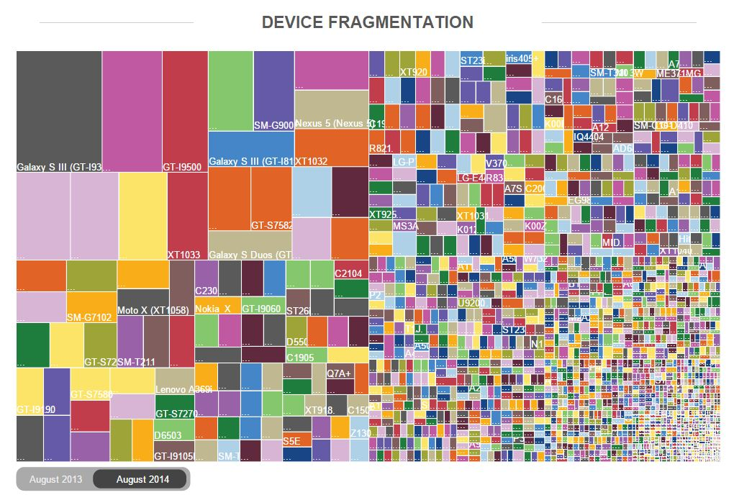

Slide 5
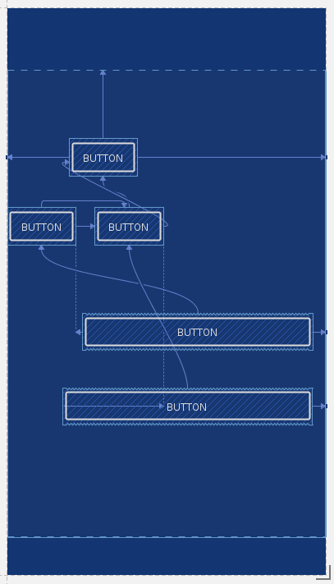
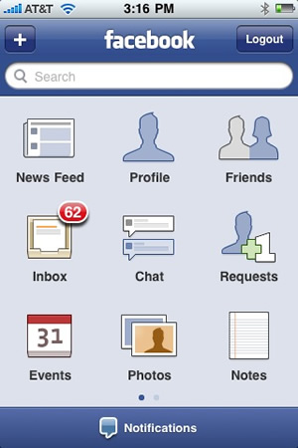
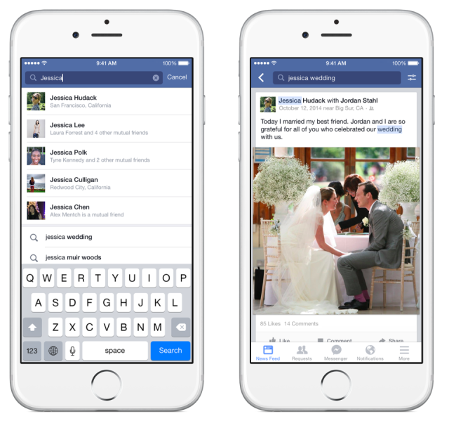
Constraints
Old Facebook with simple and less features
New Facebook Screen: more complex and features

Slide 6

History (INSPIRED FROM WEB)
Flutter was an experiment, as the developers of Google were trying to remove a few compatibility supports from Chrome, to make it smoother.
They found that they had something that rendered 20 times faster than Chrome, by seeing the potential the made the layered framework that communicated with CPU and GPU.

Slide 7
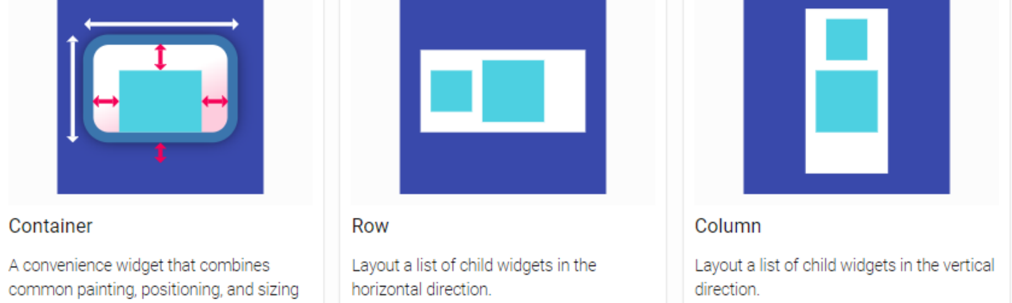
Simple and Flexible Layout

Slide 8

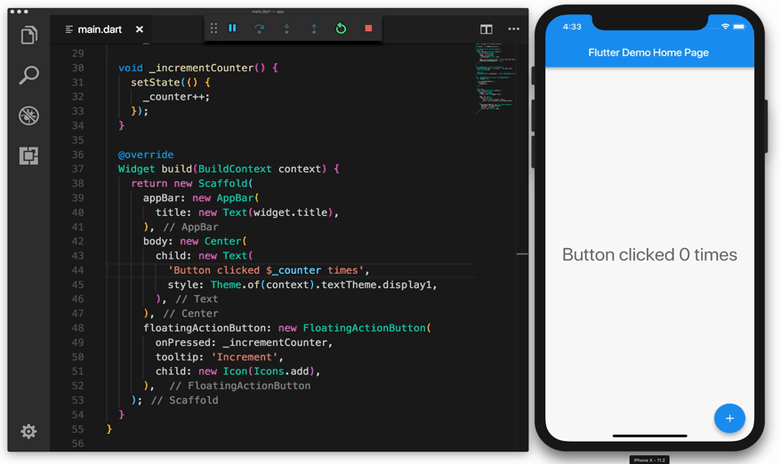
Spilt Second Reload?

