Slide 1

Flutter Development
Part Three

Slide 2

Anatomy of Flutter App
So how are layout really arranged in flutter? Let’s dive in!

Slide 3
Everything is a widget

Slide 6
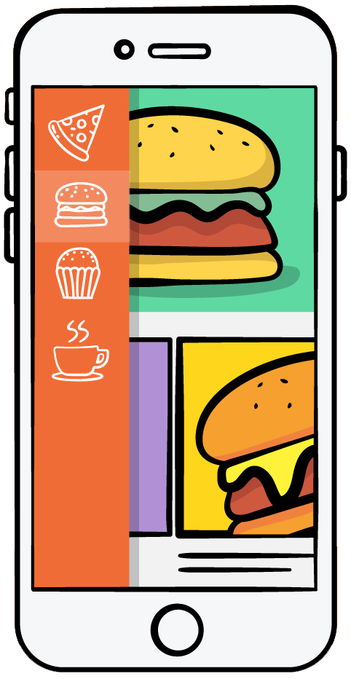

Theme : Material Widget
App Widget
Scaffold Widget
T
App Bar Widget
Container Widget
T
Column
Row
Text
Text
Icon

Slide 8
