Slide 1

Flutter Development
Part FOur

Slide 2
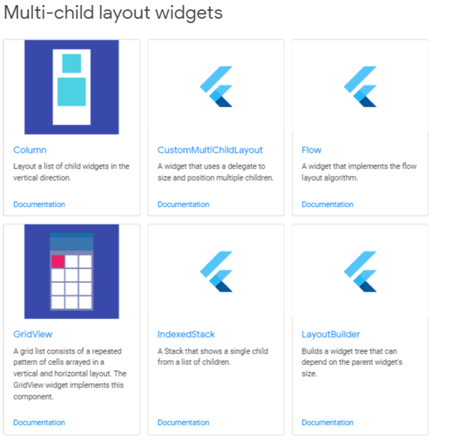
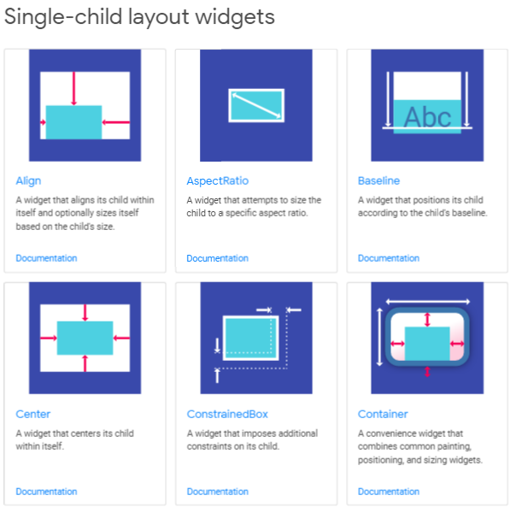
Flutter Layout Widgets

Slide 3
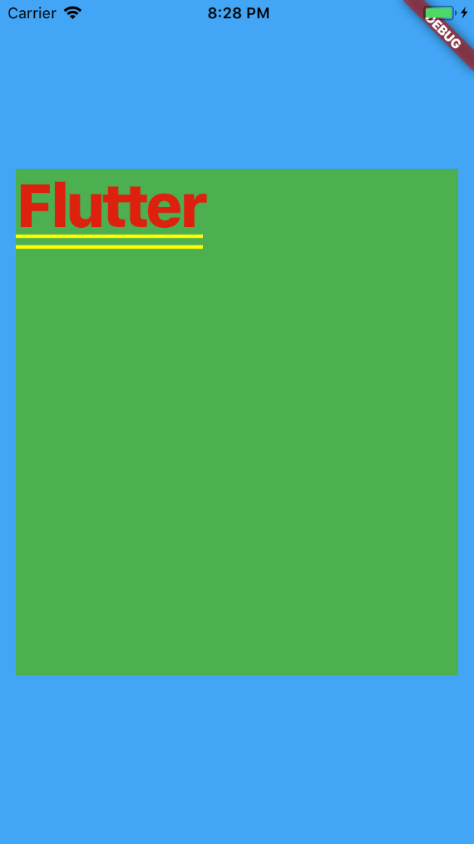
Container
It is used to contain a child widget within your parent widget, which it does by applying some styling properties on it.
Used for applying various features like:
Alignment of various child within a container.
Background color.
Border decoration or transformation.

Slide 4
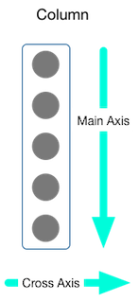
Column
Column is essential for composing layout in Flutter apps. It displays its children in vertical array.
This means the children are align vertically inside the column.

Slide 5
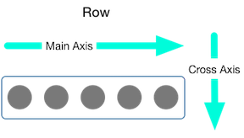
Row
The horizontal version of column is row.
It draws the children in a horizontal array.

