Slide 1

Flutter Development
Part Ten

Slide 2
SToring Data
MyApp
On Device Storage
On Web
Server
Only available in your App/ for you user
Only available in your App/ for you user
Data persists across app restarts
Data persists across app restarts
Works Offline
Works Offline

Slide 3
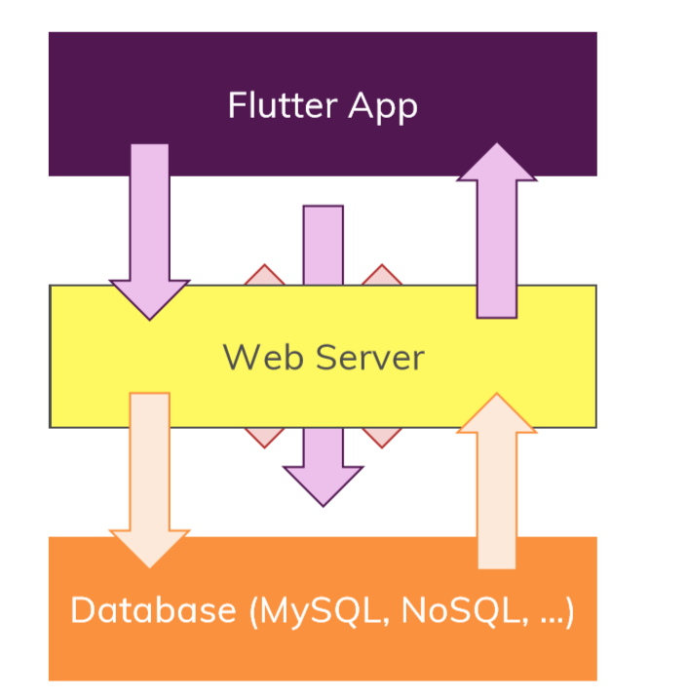
Connect Flutter To Database

Slide 4
