Slide 1

Flutter Development
Part Six

Slide 2
Object Oriented Programming
Object-oriented programming (OOP) is a programming language model in which programs are organized around data, or objects, rather than functions and logic. An object can be defined as a data field that has unique attributes and behavior.

Slide 3
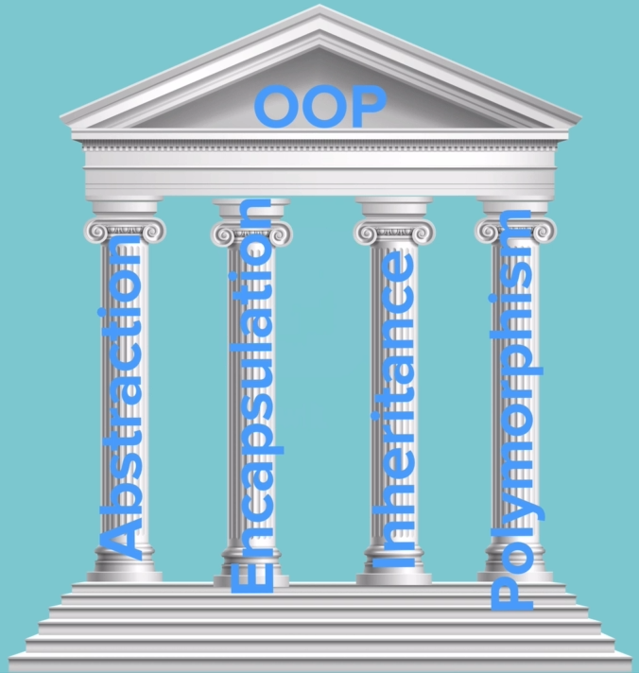
Features / Pillars of the OOP
1. Abstraction
2. Encapsulation
3. Inheritance
4. Polymorphism

Slide 4
1. Abstraction
Abstraction is a process where you show only “relevant” data and “hide” unnecessary details of an object from the user.
For example, when you login to your Amazon account online, you enter your user_id and password and press login, what happens when you press login, how the input data sent to amazon server, how it gets verified is all abstracted away from the you.
Another example of abstraction: A car in itself is a well-defined object, which is composed of several other smaller objects like a gearing system, steering mechanism, engine, which are again have their own subsystems. But for humans car is a one single object, which can be managed by the help of its subsystems, even if their inner details are unknown

Slide 5
2. Encapsulation
Encapsulation is:
Binding the data with the code that manipulates it.
It keeps the data and the code safe from external interference
Looking at the example of a power steering mechanism of a car. Power steering of a car is a complex system, which internally have lots of components tightly coupled together, they work synchronously to turn the car in the desired direction. It even controls the power delivered by the engine to the steering wheel. But to the external world there is only one interface is available and rest of the complexity is hidden. Moreover, the steering unit in itself is complete and independent. It does not affect the functioning of any other mechanism.

Slide 6
3. Inheritance
Inheritance is the mechanism by which an object acquires the some/all properties of another object.
It supports the concept of hierarchical classification.
For example: Car is a four wheeler vehicle so assume that we have a class FourWheeler and a sub class of it named Car. Here Car acquires the properties of a class FourWheeler. Other classifications could be a jeep, tempo, van etc. FourWheeler defines a class of vehicles that have four wheels, and specific range of engine power, load carrying capacity etc. Car (termed as a sub-class) acquires these properties from FourWheeler, and has some specific properties, which are different from other classifications of FourWheeler, such as luxury, comfort, shape, size, usage etc.

Slide 7
4. Polymorphism
Polymorphism means to process objects differently based on their data type.
In other words it means, one method with multiple implementation, for a certain class of action. And which implementation to be used is decided at runtime depending upon the situation (i.e., data type of the object)
This can be implemented by designing a generic interface, which provides generic methods for a certain class of action and there can be multiple classes, which provides the implementation of these generic methods.
Overloading in simple words means more than one method having the same method name that behaves differently based on the arguments passed while calling the method. This called static because, which method to be invoked is decided at the time of compilation
Overriding means a derived class is implementing a method of its super class. The call to overriden method is resolved at runtime, thus called runtime polymorphism

